Slide 1
Role-Based Access Control for Azure

Slide 2
What we talk about…
How to achieve finer-grained access management?

Slide 3
What we talk about…
What Azure Active Directory is?

Slide 4



Adoption of IAAS/PAAS in Organizations
partner@yahoo.com
IT managed identities
Owner = ellen@outlook.com
prospectivecustomer@live.com
Active Directory
Owner = aaron@hotmail.com
ellen@company.com
Owner = xyz@gmail.com
aaron@company.com
Owner = xyz@yahoo.com

Slide 5
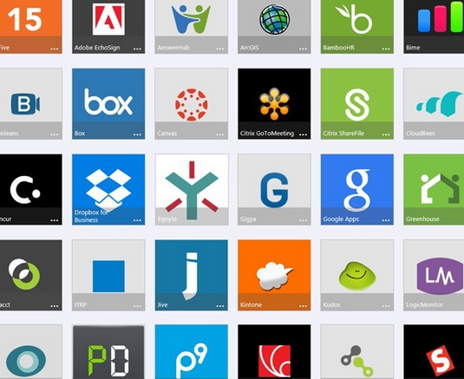


Access to Azure and rest of the cloud: Powered by Azure AD
2000+ Pre-Integrated SAAS Apps
IT managed identities
Microsoft Online Services
Users & Groups
Sync
Azure Active Directory
Roles and Role Assignments
Owner = ellen@outlookcompany.com
Active Directory
ellen@company.com
aaron@company.com
Owner = aaron@hotmailcompany.com
Microsoft Azure IAAS/PAAS
joe@partner.com
prospectivecustomer@live.com
Company In-House Developed Cloud Apps

Slide 6
Demo: Azure RBAC in action

Slide 7
Azure RBAC: First Preview Release
3 built-in roles (Owner, Contributor and Reader) available for assignment to Users, Groups and Services on Azure scopes: Subscription, Resource Group and Resources.
Access management using Azure preview portal, Command Line Tools & REST API for bulk operations.
In the new RBAC model the existing subscription administrators and co-admins become ‘Owners’ of the subscription.

Slide 8
Roles and Roles Assignments
Role is a collection of actions
Role Assignments
Role
Subject = Users or Groups or Service Identity
Scope = Directory or Subscription or ResourceGroup or Resource
 | Actions | Not Actions
Owner | *
Contributor | * | Microsoft.Authorization/*
Reader | */Read
SQL Contributor | Microsoft.SQL\* | Microsoft.Authorization/*
Tier 1 Operator | */Read + Microsoft.Compute\VirtualMachine\*

Slide 9
Access Inheritance and Resource Hierarchy
Access Inheritance
R
RG
R
R
S
RG
R
RG
R
Role Assignment
Role = ‘Owner’
Subject = AAD User
Scope = Resource
Role Assignment
Role = ‘Reader’
Subject = AAD Group
Scope = Subscription
R
Role Assignment
Role = ‘Contributor’
Subject = AAD User
Scope = Resource Group

Slide 10
Azure AD Authorization Platform
Token with group membership claims
Users and Groups
Sync
Azure Active Directory
Azure Preview Portal & APIs (Azure Resource Manager)
Active Directory
Access Check
SDK
Synced to closest geo location
Roles and Role Assignments
Roles and Role Assignments
Policy
Audit
Reason over Policy and Audit

Slide 11
Demo: Access Management

Slide 12
RBAC & Azure Resource Manager
Azure Active Directory
RBAC
RP
Roles & Role Assignments
Azure Resource Manager
Events
RP
Azure Events

Slide 13
Demo: Access Change History - RBAC and Events RP

Slide 14
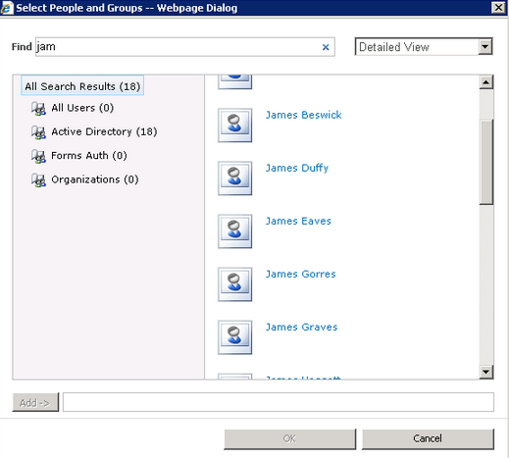
Integrate your app’s access with AAD groups
Using AAD Groups Directly
Using AAD App Roles
1
Grants access to an AAD group ‘Ellen’s Team’
App renders “people picker” using AAD Graph API
1
Publishes App Roles in AAD
Ellen
(Resource Owner)
App persists the group objectId in “permissions table”
App Developer
App Roles = “Publisher”, “Subscriber”
Accesses the resource. Token contains groups claim
2
Assigns App Roles to Users, Groups and Client Applications
2
Joe
(Member of ‘Ellen’s Team’)
App checks access by comparing groups claim value with persisted objectIds
Customer Admin
Kim -> “Publisher”
Ellen’s Team -> “Subscriber”
Accesses the resource. Token contains roles claim
roles=“Publisher”
Accesses the resource. Token contains overage claim
App queries AAD Graph API for user’s groups
3
3
Kim
App checks access using “IsInRole”
Sam
(Member of ‘Ellen’s Team’)
App checks access by comparing user’s groups with persisted objectIds

Slide 15
What’s ahead
Custom Roles
Access Change History
Reporting over Policy and Audit
Just-in Time Access
Conditional Access
Resource tag based Access Control
User attribute based Access Control
Available to 3rd Party Applications
Separation of Duties

Slide 16

For more information
Windows Server
Windows Server Technical Preview
http://technet.microsoft.com/library/dn765472.aspx
System Center
System Center Technical Preview
http://technet.microsoft.com/en-us/library/hh546785.aspx
Azure Pack
Azure Pack
http://www.microsoft.com/en-us/server-cloud/products/ windows-azure-pack
Microsoft Azure
Microsoft Azure
http://azure.microsoft.com/en-us/

Slide 17

Resources
Learning
Sessions on Demand
Microsoft Certification & Training Resources
http://channel9.msdn.com/Events/TechEd
www.microsoft.com/learning
TechNet
Developer Network
Resources for IT Professionals
http://microsoft.com/technet
http://developer.microsoft.com

